Slide 1
CAR Calibration Session “Good” CAR, “Bad” CAR Review
Team A: Samantha Bang, Funny Li, Balina Ling, Catherine Qiu
Sep 18, 2012

Slide 2
Agenda
Sample 1 CAR Needing Improvement
CAR No. 11399522 - WonSeon
Sample 2 CAR Needing Improvement
CAR No. 11399506 - Catherine
3. Sample 3 Good CAR No. 11399065 - Balina
Sample 4 Good CAR No. CAR 123910414 -Funny

Slide 3
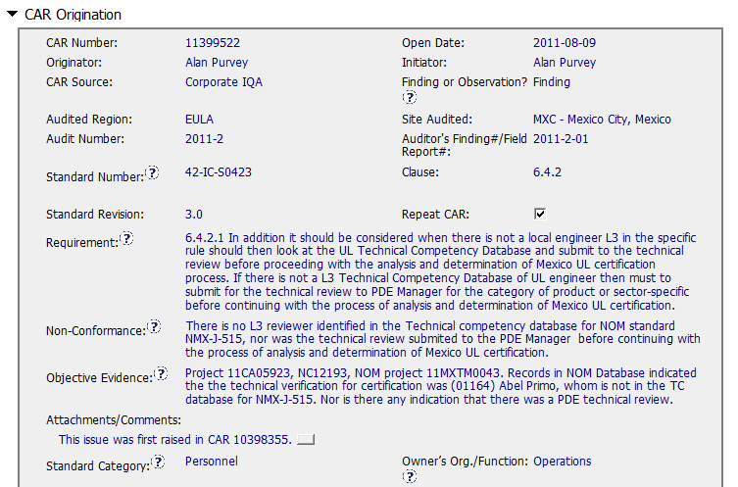

Sample 1 - CAR Needing Improvement CAR No.11399522

Slide 4
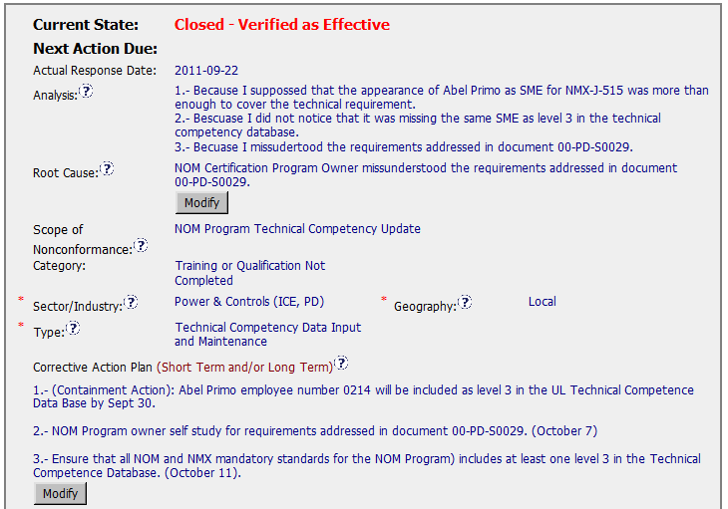
Sample 1 - CAR Needing Improvement CAR No.11399522
Analysis & Root Cause – open to further discussion.
Need to ask more “Why misunderstood?” “Lack of training?” “ Lack of experiences?”
Corrective Action Plan –
It addresses the root cause as it is stated, but the root cause is deficient.
Notes:
00-QA-S0006 (#18.0) - Corrective Action Request Process

Slide 5
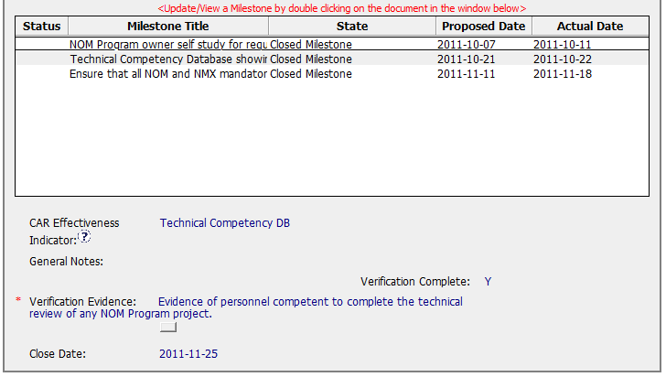
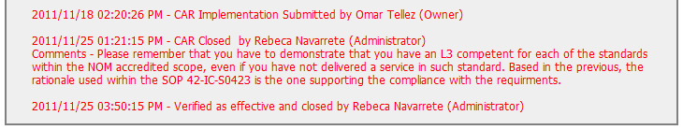
Sample 1 - CAR Needing Improvement CAR No.11399522
CAP– recommend to add captions ex)“Containment: ”, “Verification: ”
Verification Evidence – need more specific objective evidences examined
Verification –enough time need to be allowed for new records to be examined
Verification occurred one day after the CAR was closed. This did not allow enough time to verify that the problem did not recur.

Slide 6
Sample 1 - CAR Needing Improvement CAR No. 11399522 Discussion
Analysis & Root Cause
– open to further discussion. Need to ask more “Why misunderstood?”
“Lack of training?” “ Lack of experiences?”
Corrective Action Plan
– It addresses the root cause as it is stated, but the root cause is deficient.
CAP
– recommend to add captions ex)“Containment: ”, “Verification: ”
Verification Evidence
– need more specific objective evidences examined
Verification
–enough time need to be allowed for new records to be examined

Slide 7
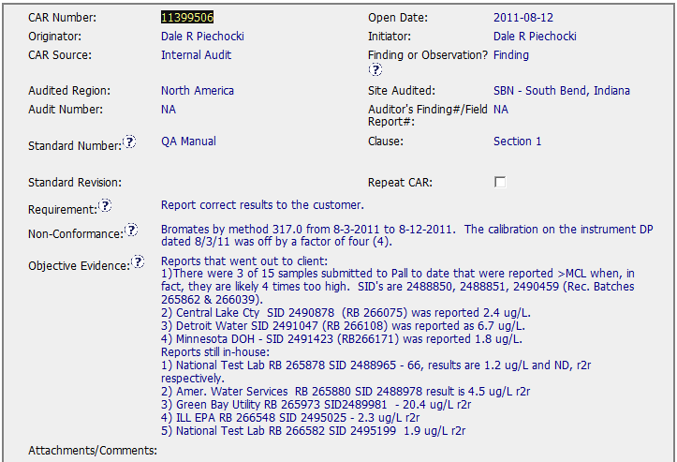
Sample 2 - CAR Needing Improvement CAR No. 11399506
1
1. The non-conformance was not clearly stated.

Slide 8
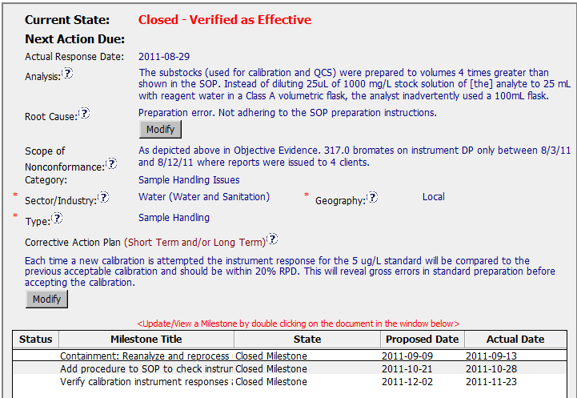
Sample 2 - CAR Needing Improvement CAR No. 11399506
2
2. The root cause looks like a symptom, the CAR owner should go on to explore the root cause.
3
3. The Corrective Action Plan is not different from below milestones.
4
4. For milestone 2, see below slide

Slide 9
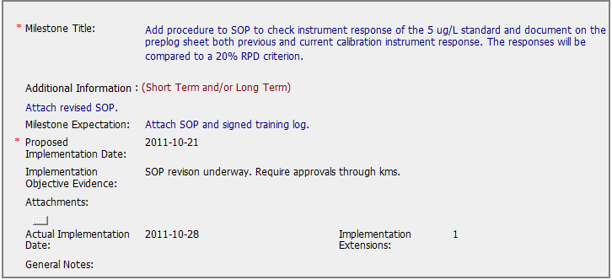
Sample 2 - CAR Needing Improvement CAR No. 11399506
4
a. The action has no linkage to the root cause
4
b. The action hasn’t finished yet, but the milestone was closed.

Slide 10
Sample 2 - CAR Needing Improvement CAR No. 11399506 Discussion
The non-conformance was not clearly stated.
The root cause looks like a symptom, the CAR owner should go on to explore the root cause.
The Corrective Action Plan is not different from below milestones.
a. The action has no linkage to the root cause
b. The action hasn’t finished yet, but the milestone was closed.
The analysis is good.
However the root cause, which states that the FR did not proof the report before it was submitted, is not sufficient.
Lack of inspection, in my opinion, is not the root cause.
The question that needs to be answered, is why Devi (whether he be a trainee or senior FR) was not able to complete the report with the correct response.
The practice of writing reports on behalf of other FRs was stopped, but Devi’s own reports may be at fault, even today.

Slide 11
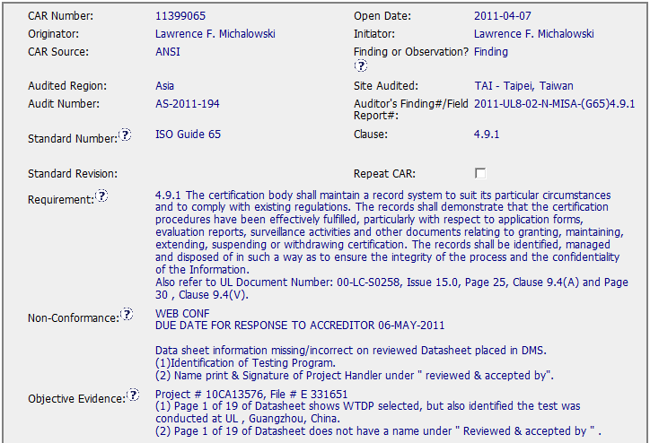
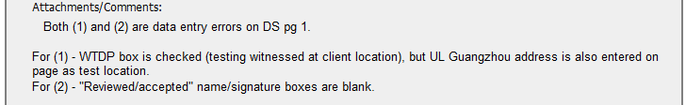
Sample 3 Good CAR No. 11399065

Slide 12
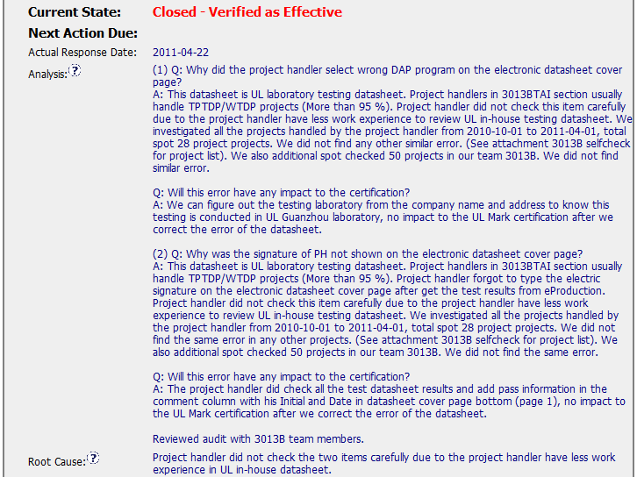
Sample 3 Good CAR No. 11399065
1
1. Very clear & logical analysis with investigation and facts. And the root cause is reasonable and complete based on the analysis.

Slide 13
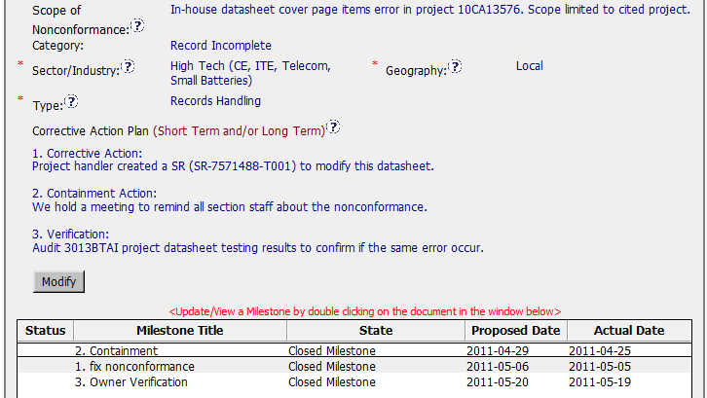
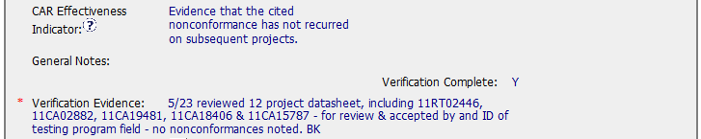
Sample 3 Good CAR No. 11399065
2
2. Scope tells us how widespread the problem is, for this CAR, it is just limited to cited projects.
3
3. Containment action fixed the object evidence, and corrective action address the root cause, have final milestone for owner’s verification of effectiveness.

Slide 14
Sample 3 Good CAR No. 11399065 Discussion
Very clear & logical analysis with investigation and facts. And the root cause is reasonable and complete based on the analysis.
Scope tells us how widespread the problem is, for this CAR, it is just limited to cited projects.
Containment action fixed the object evidence, and corrective action address the root cause, have final milestone for owner’s verification of effectiveness.

Slide 15
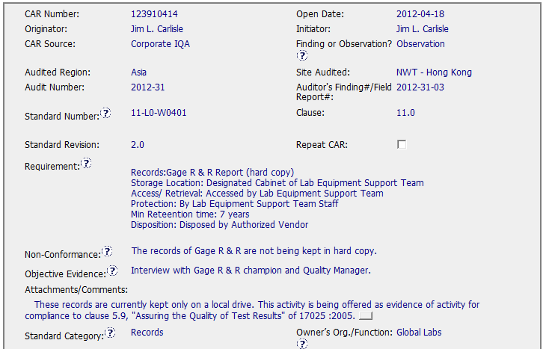

Sample 4 Good CAR No. 123910414

Slide 16
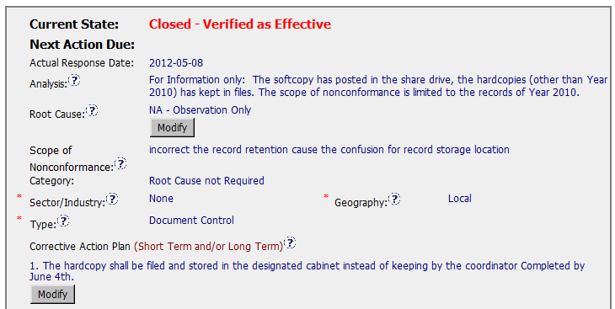
Sample 4 Good CAR No. 123910414
Analysis– Observation need no root cause analysis.
However, additional information is provided for logical and clear corrective action plan.
Corrective Action Plan
– fix the objective evidence

Slide 17
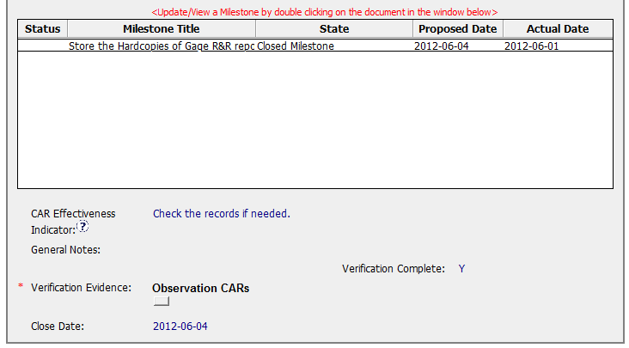
Sample 4 Good CAR No. 123910414

Slide 18
Sample 4 - Good CAR No. 123910414 Discussion
Analysis & Root Cause
- Observation need no root cause analysis.
However, additional information is provided for logical and clear corrective action plan.
Corrective Action Plan
– Fix the objective evidence.

Slide 19
THANK YOU.

Slide 20
Case Study
CAR Number: 11399769
CAR Number: 123910694
CAR Number: 123910200
CAR Number: 123910055
Team:
Bill Konigsfeld, Jim Oates, Julianne Heinzinger, Gunsimar Paintal

Slide 21

Overall Team Considerations:
Avoid names or other identification when possible.
Make sure we read all comments and history, since information may be contained which helps with explanations.
Look for improvements and opportunities with all CARs.

Slide 22
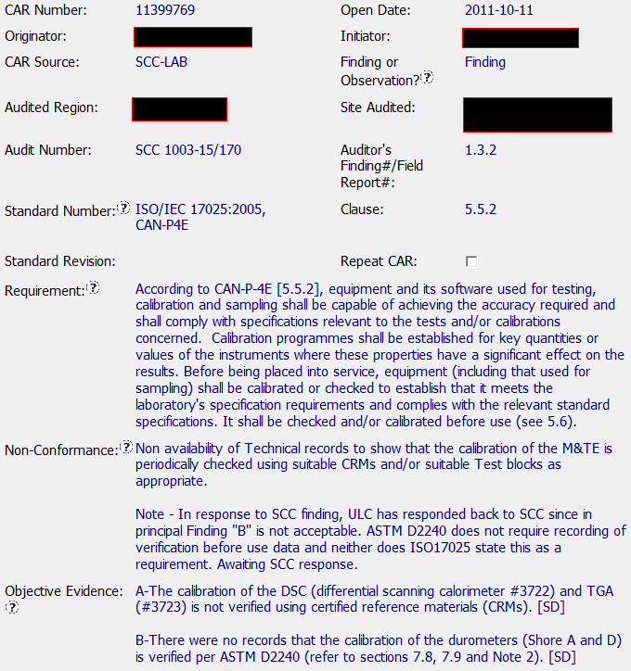
Better CAR – Sample 1
CAR Number: 11399769

Slide 23
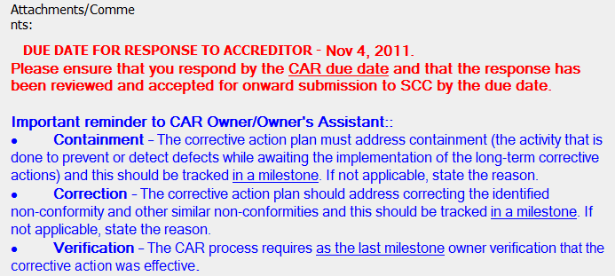
Better CAR Sample 1
CAR Number 11399769

Slide 24
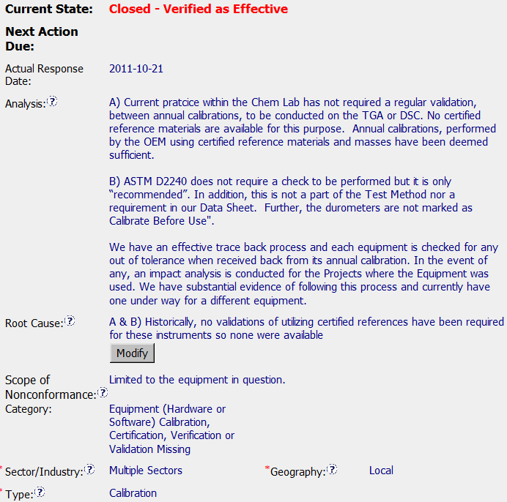
Better CAR – Sample 1
Analysis done by CAR Owner, being the sole person responsible for Calibration Services for the location.
Analysis reiterated the practice.
Analysis further captured an ASTM recommendation v/s requirement. (History - 2011/10/11 05:15:26 PM )
Additionally, identified existence of an effective traceback process which reinforces the fact that there were no potential risks of not performing “Calibrate/Verify before use”.
NCR Obj. evidence > Analysis > RCA > CAP …all link up. Short & sweet ☺
CAR Number: 11399769

Slide 25
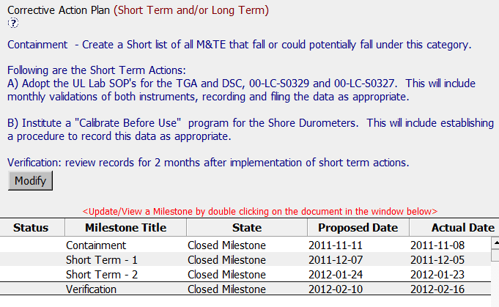

Better CAR – Sample 1
MS Evidence:
See the attached spreadsheet for a list of equipment which falls into the category of Calibrate/Validate before each use.
CAR Number: 11399769
MS Evidence:
Attached: Links to CC records for reference materials required for TGA and DSC Verification. Links to LEM records for the Durometer types A and D reference block sets.
MS Evidence:
Training Records for
1. Validation procedure TGA and DSC 2. Training record for validation procedure of Shore durometers.
MS Evidence:
1. Attached copies of the TGA and DSC verifications. In accordance with discussions between Lab and the auditor (copy attached) there are currently no validation records required for the Durometers. See also "General Notes", below. 2. Attached SOPs for the TGA and DSC verifications.

Slide 26
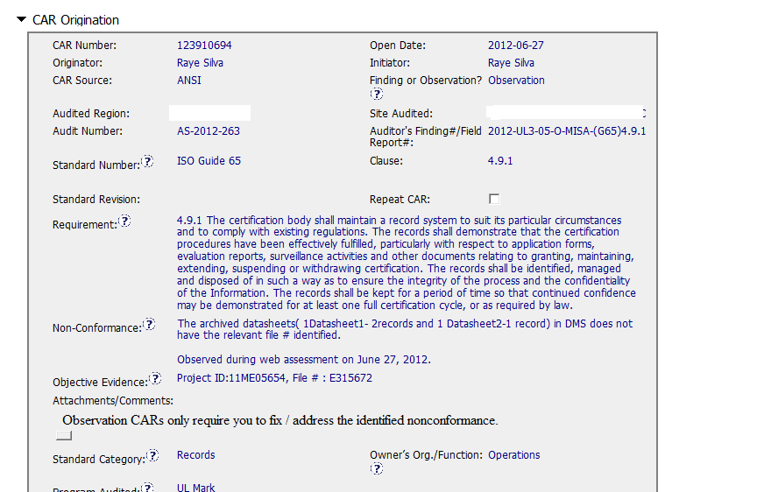
Better CAR – Observation Sample 2
CAR Number: 123910694
Records issue
Nonconformance Details
Issue: file number missing in datasheets

Slide 27
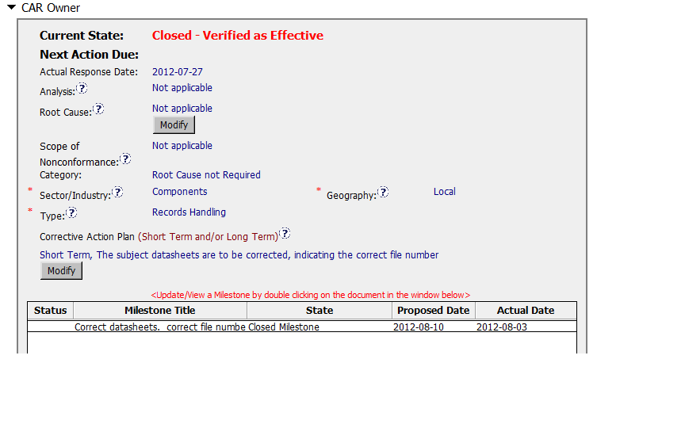

Better CAR – What corrective actions are expected for this Observation CAR?
Observation: analysis, root cause & scope not required - reference FAQ 15, # 3
3. The following are NOT required for Observation CARs: · Analysis –
Enter “Not Applicable” in this field. · Root Cause statement – Enter “Not Applicable” in this field. · Scope of Nonconformance – Enter “Not Applicable” in this field.
Root Cause category - FAQ 26: Root Cause not Required Observation/Suggestion/Opportunity for Improvement does not require root cause.
CAR Num
Response Details
OBSERVATION CARs
Observation CARs require that you:
1. Fix the problem that is identified in the “Objective Evidence”.

Slide 28
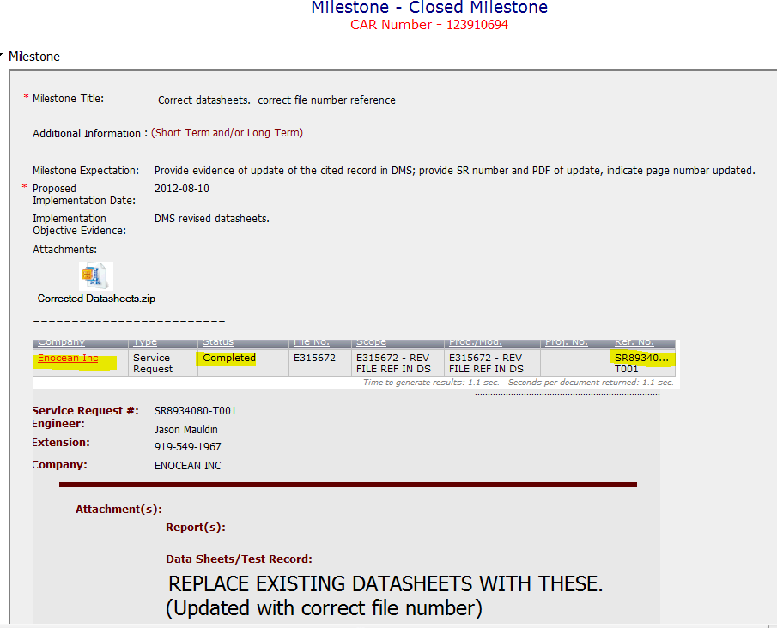
CAR Opportunity for Improvement - Fix
Fix Details
SR issued to update 5 datasheets (in zip file); vol. 2 sec 1 & 2

Slide 29
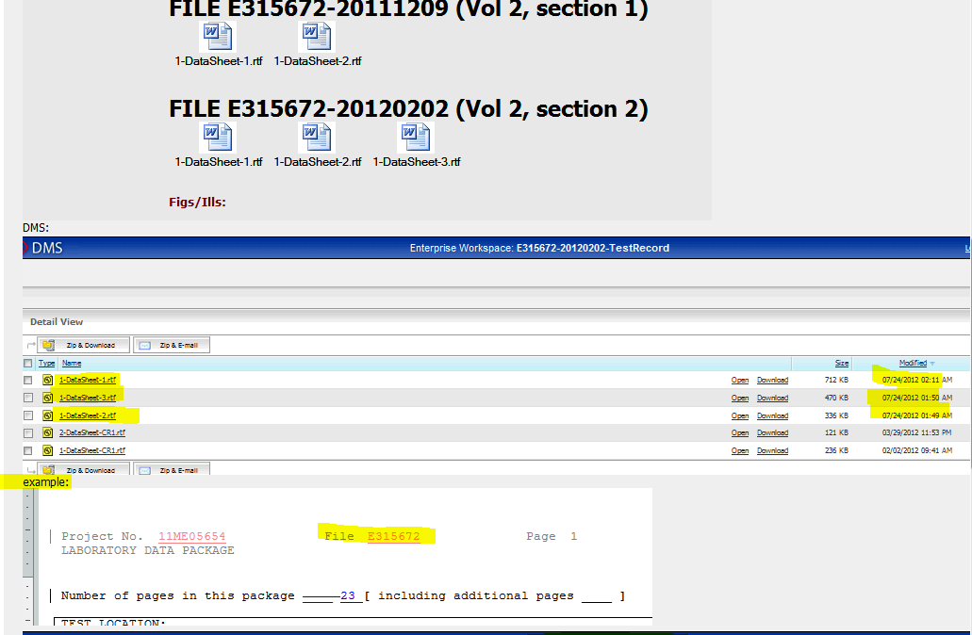
CAR Opportunity for Improvement – Fix (cont.)
Datasheets updated
in DMS

Slide 30
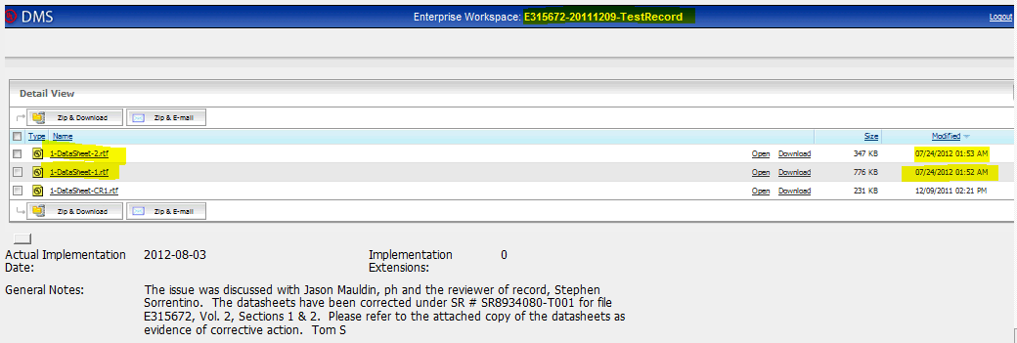
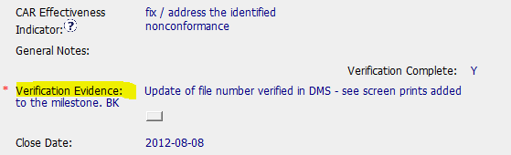

CAR Opportunity for Improvement - Fix (cont.) / verification
Verification – closed & verified same day

Slide 31







Opportunity

Slide 32
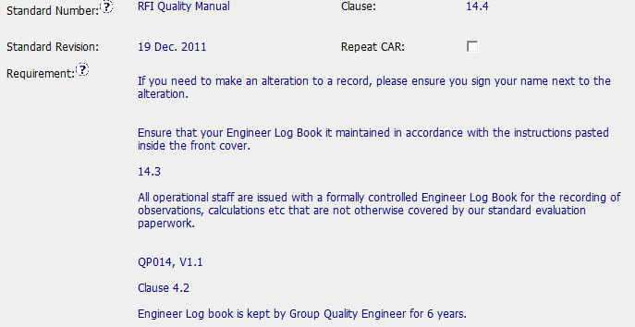
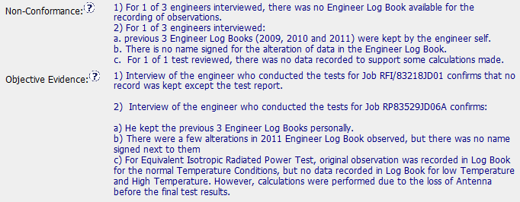
CAR 123910200 – Improvement Opportunity
Nonconformance Details

Slide 33
What corrective actions are expected for this Observation CAR?
Q: What does an Observation CAR need to address?
A: The objective evidence

Slide 34
What corrective actions are expected for this Observation CAR?
1. Give log books to the engineers
2a. Store completed log books in correct locations
2b. Correct the notations within log books (training?)
2c. Locate the missing data.

Slide 35
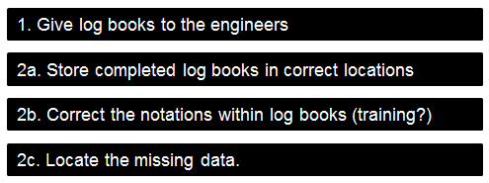
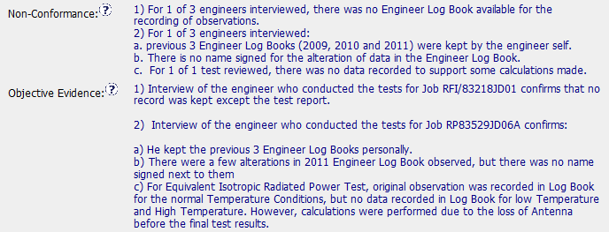
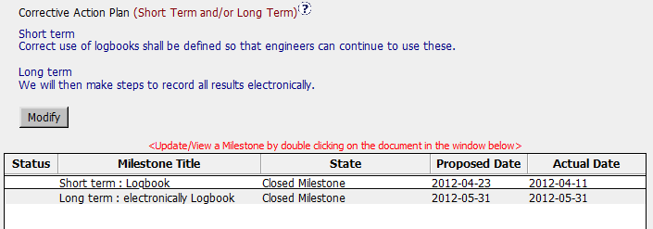
Expected Corrective Actions
Corrective Actions

Slide 36
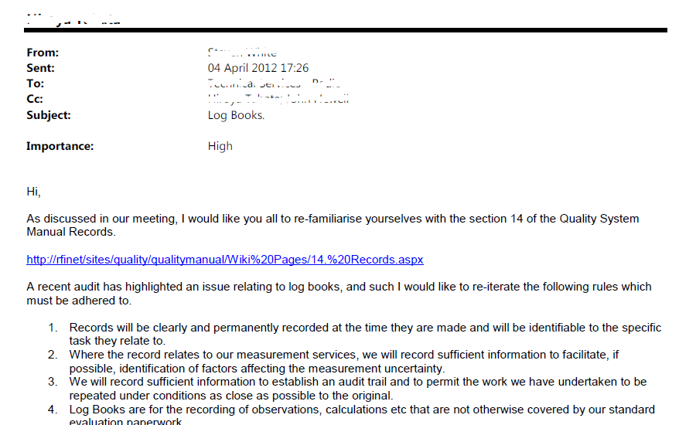
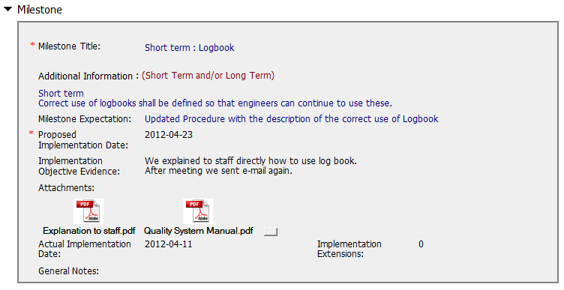
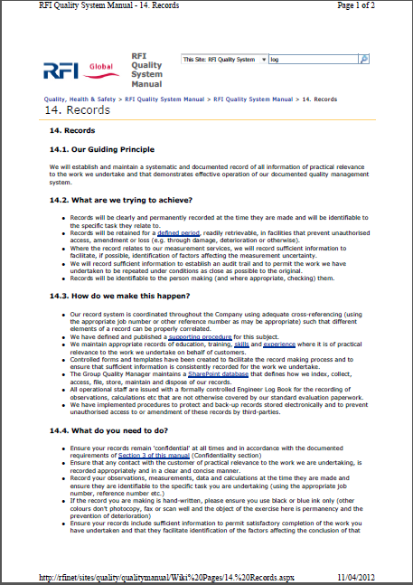
First Milestone
Email to staff
Requirements
Expected Corrective Actions

Slide 37
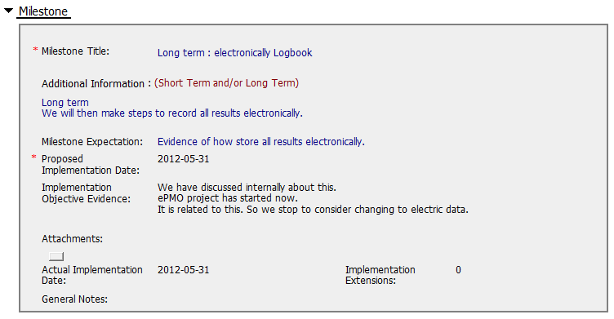
Second Milestone
Second Milestone essentially cancelled
Expected Corrective Actions

Slide 38
Were corrective actions appropriate?
No log books were given to engineers
No evidence that completed logbooks were relocated
Expected Corrective Actions
Emailed “training”, but without confirmation
No evidence the missing data was located

Slide 39
Summary
This is an Observation CAR opened during an IQA Audit
CAR response was submitted 10 days after assignment to Owner
Implementation was Overdue for 1 day
First milestone completed 43 days after assignment of CAR to Owner
Second milestone and CAR closure occurred 108 days after assignment of CAR to Owner
History contained no other relevant information.
Notes Link to CAR

Slide 40
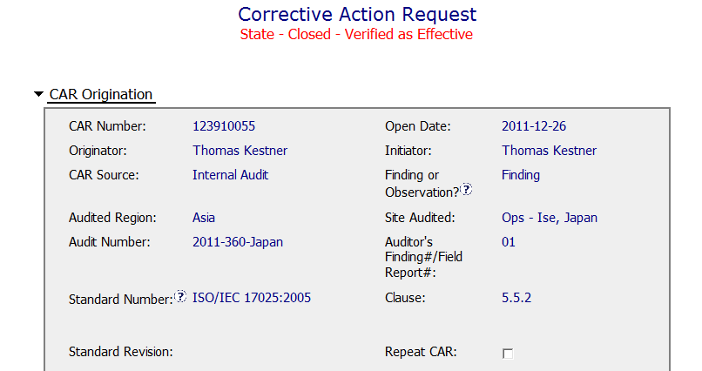
Opportunities for Improvement – CAR # 4
Nonconformance Details
Nonconformance Details
OBS: Could be added here if wanted, but not needed since it is include above.

Slide 41
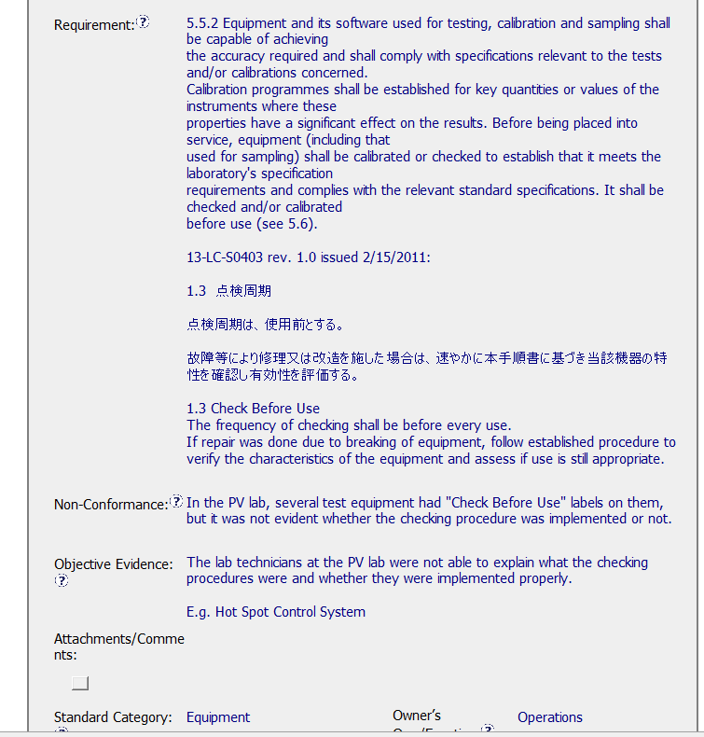
Opportunities for Improvement – CAR # 4
Requirement Repeated from 17025 and then from local documentation
The non-conformance does not include any specific applicable equipment. Depending upon the outcome, this might be needed to check the impact on projects.
Issue is the lab techs did not know the check before use procedures.
Nonconformance Details
Nonconformance Details
Translation is a good practice, this way all know the requirement
TIP: Size of population could be useful. X of X interviewed were not able . . .

Slide 42
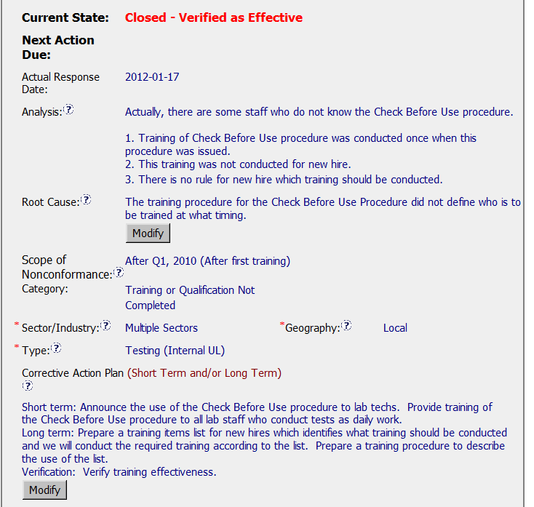
Opportunities for Improvement – CAR # 4
Corrective Actions
OBS: Wonder why the auditor could not find anyone who knew the “Check Before Use Procedure” during the audit.
ANALYSIS: Not sure who was consulted and why the new hires became the focus of the issue.
SCOPE: Since it has not been determined that it is only the new hires who could not explain checking before use, this scope is perhaps a bit limiting.
ROOT CAUSE: Training cited as the root cause without sufficient analysis.

Slide 43
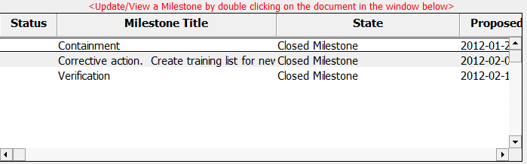
Opportunities for Improvement – CAR # 4
Corrective Actions

Slide 44
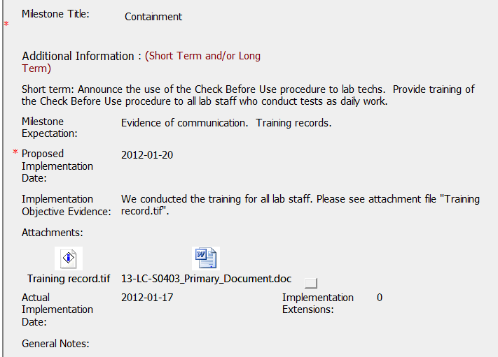
Opportunities for Improvement – CAR # 4
Milestone 1 - Containment
Four different training sessions, sign-in records attached, a total of 40 people received training.
Attached document is local language – not clear how this addressed the issue. A note of explanation in General Notes could help.
Evidence was included that training took place and the document to which the training occurred was included.

Slide 45
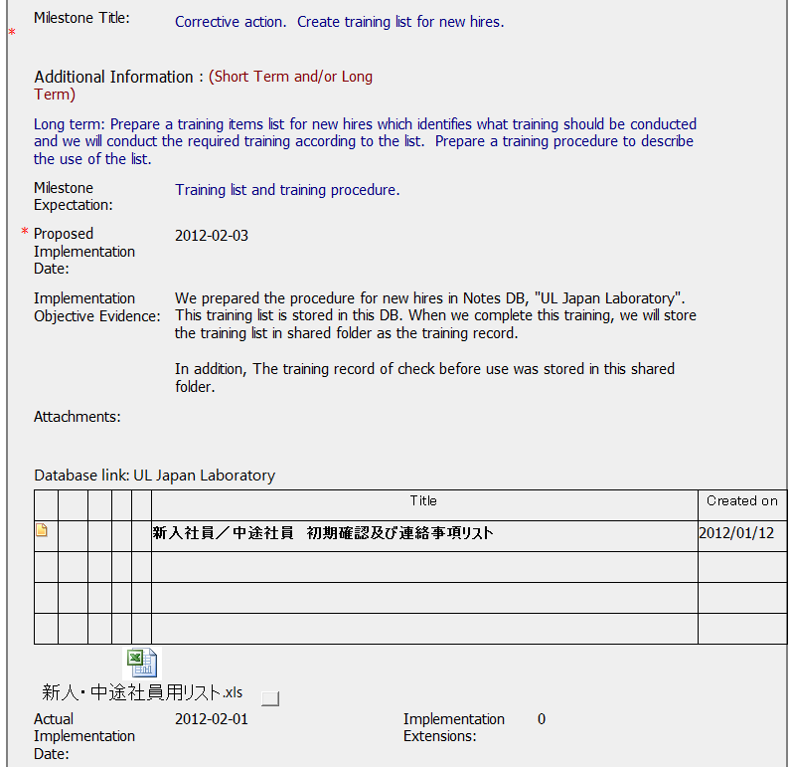
Opportunities for Improvement – CAR # 4
Milestone 2 – Corrective Action
A new hire checklist was added to for this milestone, however since it is in local language, it is not clear who will receive this training. It leads to questions:
Will it be just lab techs?
Will it include the Project Handlers and Reviewers since they are the ones the receive the data from the lab?
Evidence was included that a new hire checklist was created and stored.

Slide 46
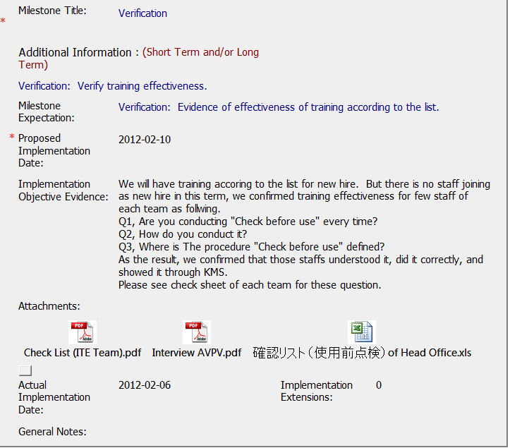
Opportunities for Improvement – CAR # 4
Milestone 3 – Owner Verification
Verification done by interview and the reason why was provided. The three questions listed below we assume to be the same three questions in the attachments. All attachments are the same thing, but for different groups. Sample on next page.

Slide 47
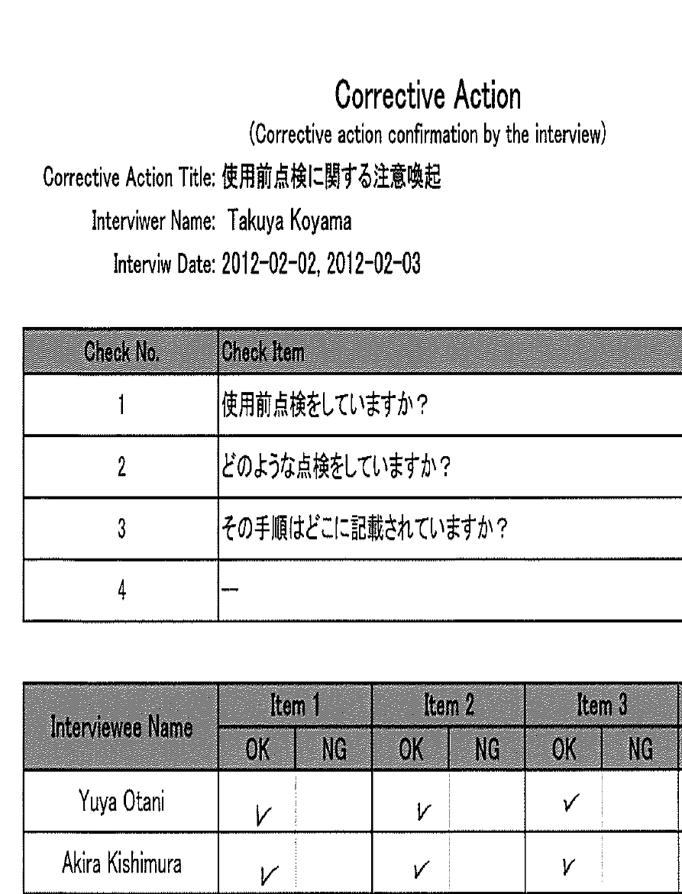
Opportunities for Improvement – CAR # 4
Milestone 3 – Owner Verification

Slide 48
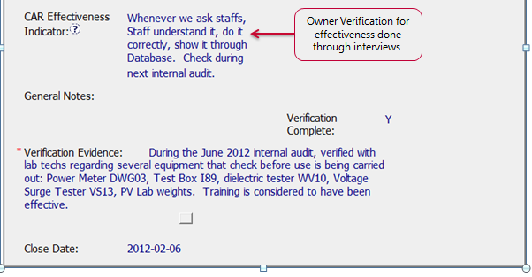
Opportunities for Improvement – CAR # 4
Verification
Initials and Date of the person doing the verification are suggested.
IQA Verification – watched and recorded equipment for which “checking before use” and equipment verified was recorded in the verification evidence.
It is unclear if any record of the Verification before use is required by the PV lab in Japan. The Calibration procedure 13-LC-S0402 is written in Japanese and this could not be verified.

Slide 49
Opportunities for Improvement – CAR # 4
Summary
It is not clear how the population was limited to those hired after Q1-2010.
Unclear how it was determined that training was the problem.
Training was done but nothing addressed why the lab techs were ignoring the “check before use” stickers.

Slide 50






Slide 51
GOOD CAR BAD CAR Auto Review, Analysis, Stats And Opinion
The original mission of GoodCarBadCar was to advance, promote, and aggrandize the Good Car. Hand in hand with that, GoodCarBadCar always had at heart an assignment that would, in effect, dethrone the bad car, banish the frumpy car, and eliminate boring vehicular abominations. Preferably sooner rather than later.

Slide 52
CAR Number:123910646
Team B’s selection for a BAD CAR. Concerns - technical issue and technical understanding vs. CAR analysis.
In choosing a BAD CAR – I (Karen) looked at mine first, and figured I’d leave those for everyone else to use…

Slide 53
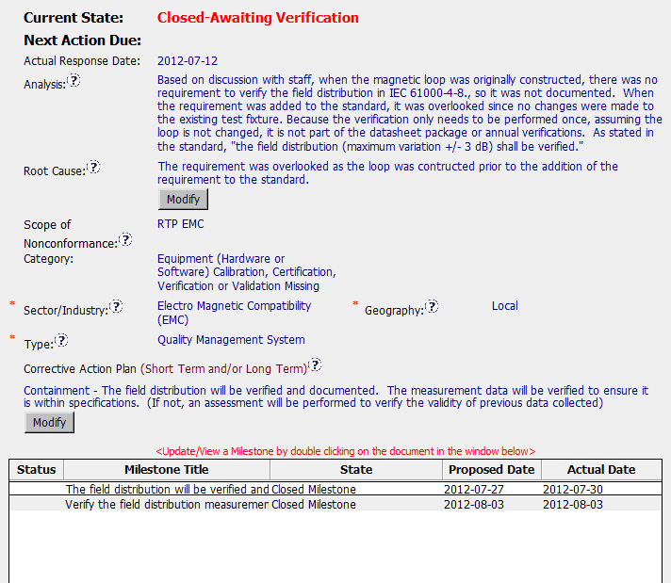
There are no Stakeholders.
The analysis seemed
to miss the problem of
the updated standard
not being properly
Implemented. If I understand correctly the standard now required the field distribution to be verified and documented regardless of when the loop was created.

Slide 54

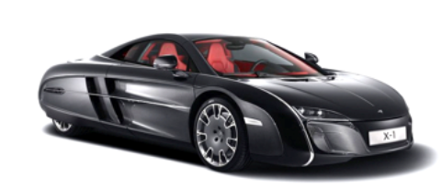
The Root Cause is a restatement from the Analysis.
The scope indicates RTP EMC, in the Analysis it didn’t indicate if the other EMC offices have verified and documented the field distribution.
There are only two milestones where we should have three of Containment, Corrective Action and Verification
In the history – indicates that the problem could be greater than not recording the field distribution, but that the result could cause a problem with other data collected.
My suggestion for the Containment to verify the field distribution
For Corrective Action - review of updated Standard requirements
Verification – of the field distribution verification was documented AND a review of how the next updated standard was handled.

Slide 55
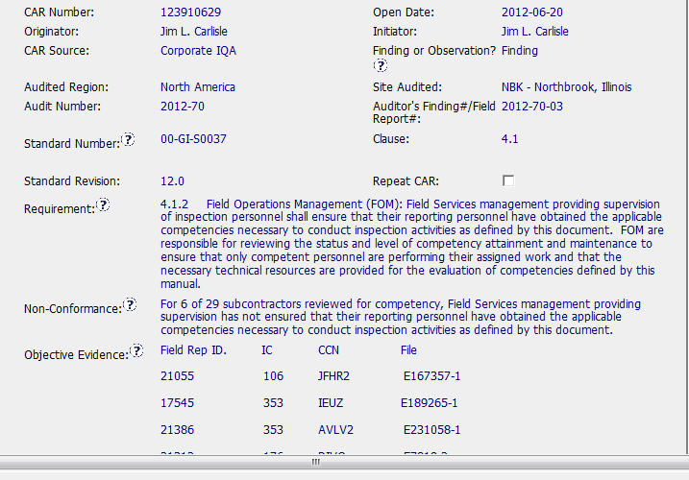
Good CAR: 123910629

Slide 56
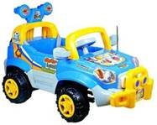
Non-Conformance: Competency requirements not being documented or met
Several samples found and used as objective evidence of the NC
Analysis showed separate root causes participating to different samples
Both containment action and corrective action addressed the separate root causes

Slide 57
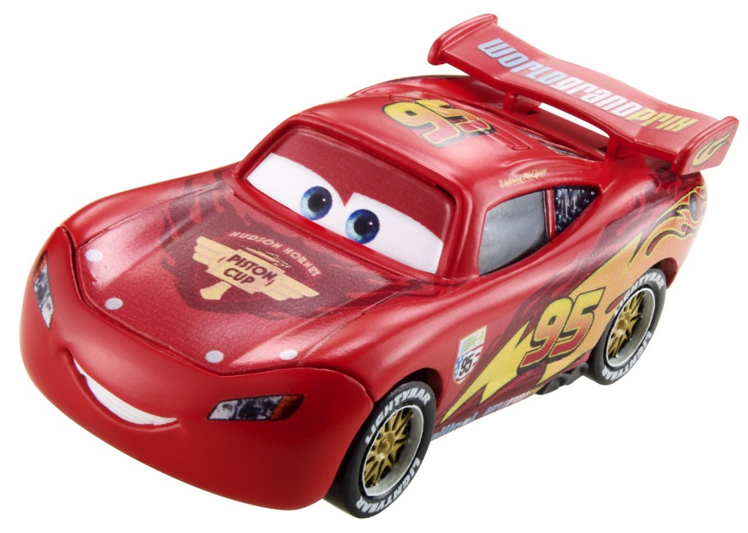
Thorough containment
Training plus IT process changes to prevent recurrence
Effectiveness verification included as milestone
All due dates met.
Communication with
CAR Admin

Slide 58
Questions/Discussion

Slide 59
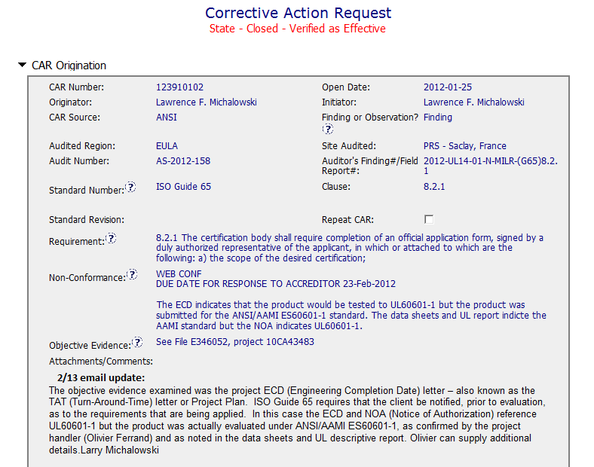
Team B’s selection for a GOOD CAR.
CAR # 123910102

Slide 60
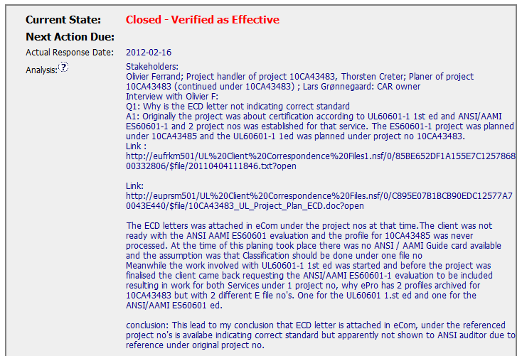
There are Stakeholders.
The analysis is very detailed, and it is well explained what‘s happened

Slide 61

Root Cause is the conclusion of the analysis
We have 3 milestones: Containment; Corrective Action and Verification

